Slide 1

Project Report
Team Ehrgo Health
04/10/16
Notes:
This template can be used as a starter file to give updates for project milestones.
Sections
Right-click on a slide to add sections. Sections can help to organize your slides or facilitate collaboration between multiple authors.
Notes
Use the Notes section for delivery notes or to provide additional details for the audience. View these notes in Presentation View during your presentation.
Keep in mind the font size (important for accessibility, visibility, videotaping, and online production)
Coordinated colors
Pay particular attention to the graphs, charts, and text boxes.
Consider that attendees will print in black and white or grayscale. Run a test print to make sure your colors work when printed in pure black and white and grayscale.
Graphics, tables, and graphs
Keep it simple: If possible, use consistent, non-distracting styles and colors.
Label all graphs and tables.

Slide 2
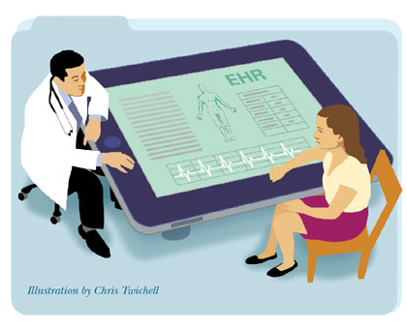
Project Overview
Plugin architecture to capture treatment analysis from EHR
Patient Portal: allowing patient to enter personal information and leverage commonly-used technology APIs such as fitbit
Provider EHR plugin: show warnings between allergies/medication and optimize treatment strategies
Notes:
What is the project about?
Define the goal of this project
Is it similar to projects in the past or is it a new effort?
Define the scope of this project
Is it an independent project or is it related to other projects?
* Note that this slide is not necessary for weekly status meetings

Slide 3
Current Status
Web pages
Code implementations
Notes:
* If any of these issues caused a schedule delay or need to be discussed further, include details in next slide.

Slide 4
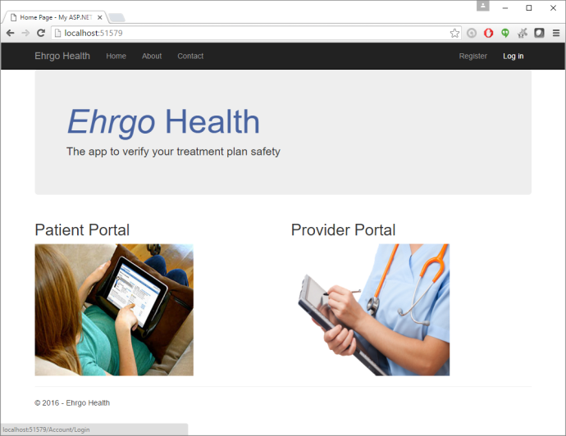
Current Status-Home Page

Slide 5
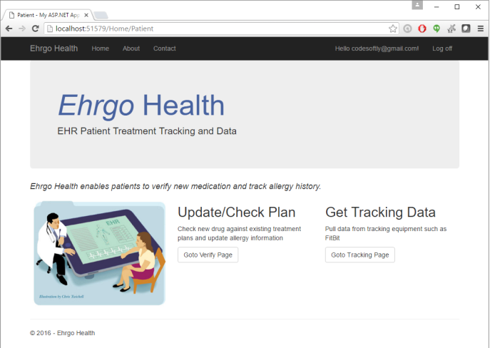
Current Status-Patient Portal

Slide 6
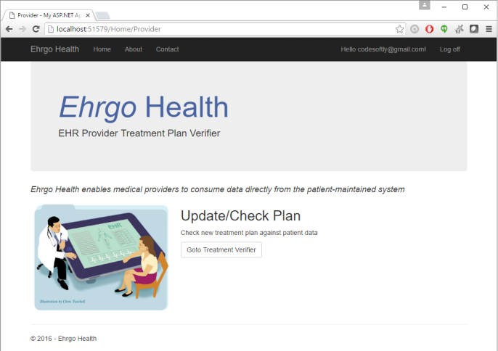
Current Status-Provider Portal

Slide 7
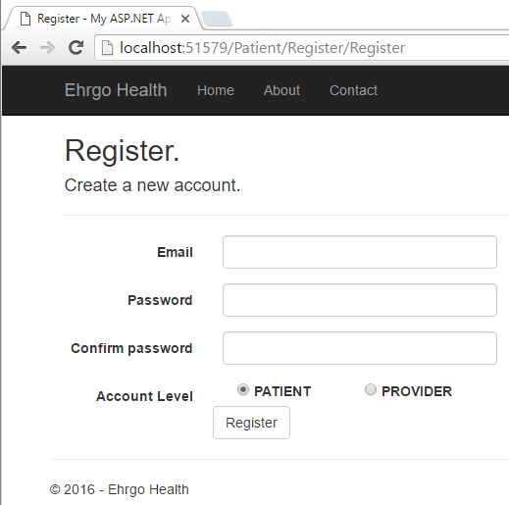
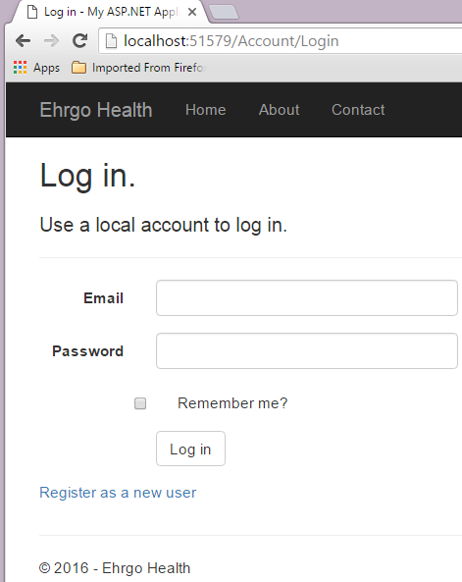
Current Status-Register and Login Pages
Register
Login

Slide 8

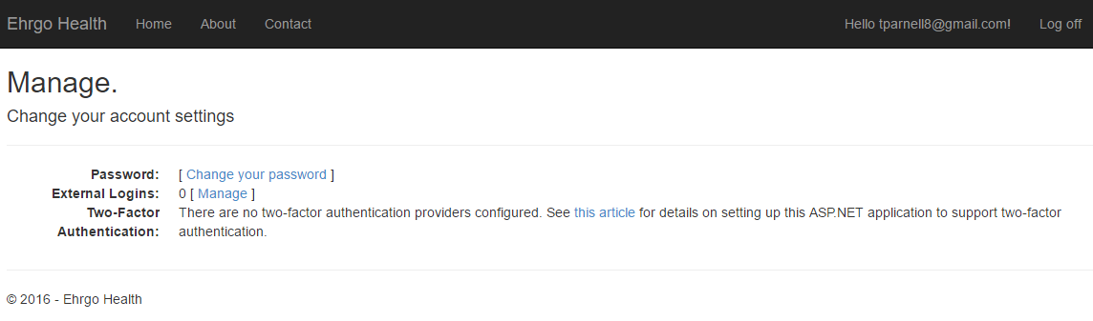
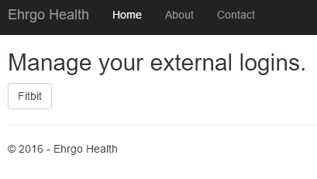
Current Status-Data Interoperation

Slide 9
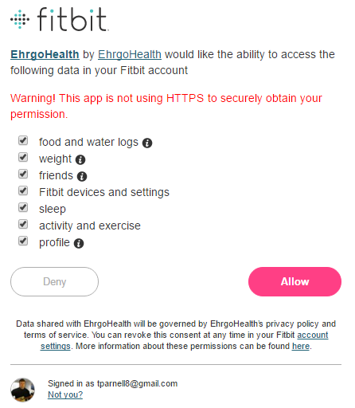
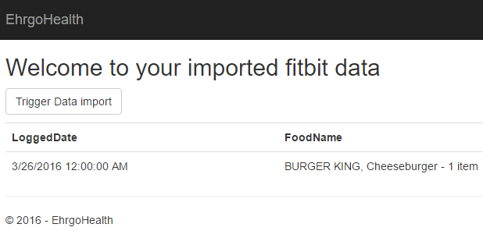
Current Status-Data Interoperation
External Login
Imported Data

Slide 10
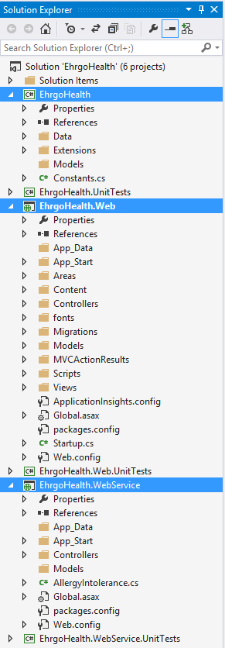
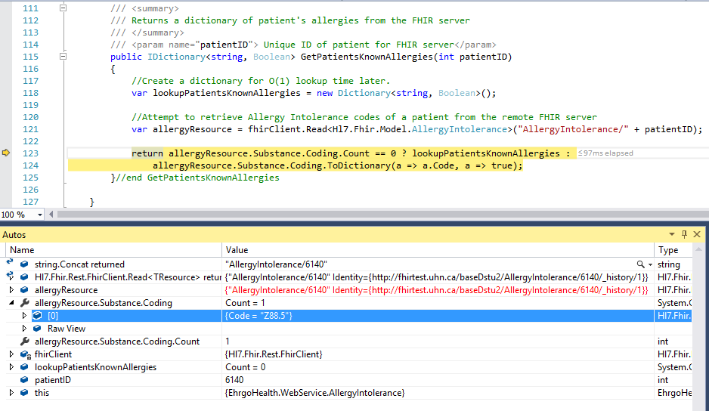
Current Status-Code Implementation

Slide 11
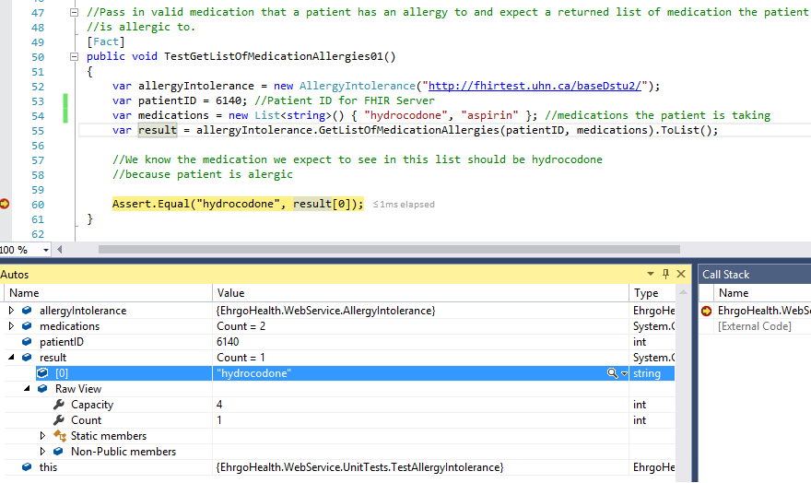
Current Status-Code Implementation

Slide 12
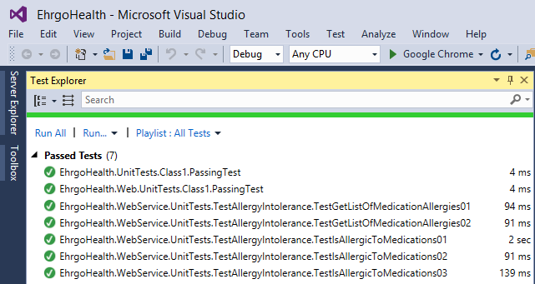
Current Status-Code Implementation

Slide 13
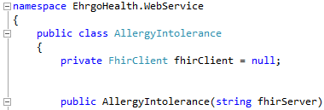
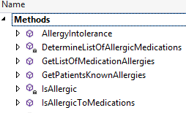
Further Research
The information in the AllergyIntolerance resource of FHIR provides the data needed to track individual patient drug allergies.
Codes from elements in the AllergyIntolerance resource can be cross-referenced with SNOMED CT and RxNorm to provide standard names of clinical drugs.
FHIR AllergyIntolerence Resource
Data relating to drug allergies and interactions is retrieved
Decision Logic implementation
Logic is implemented to create an alert system for potential issues with current treatment plan

Slide 14
Plans for next deliverable
Finish up implementation of the rest backend code
Create UI against the backend
Fix bugs and test the application
Final product will be deployed to Azure from github

Slide 15
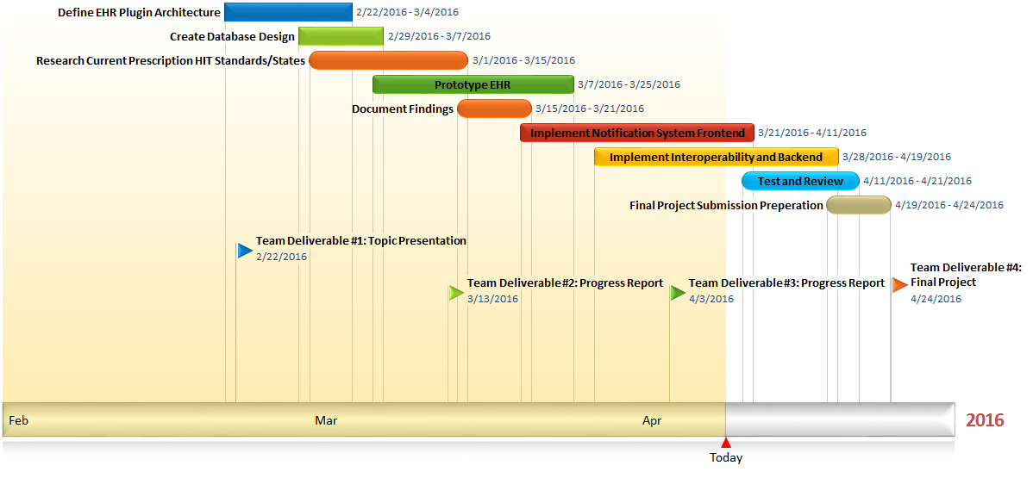
Progress Chart

Slide 16
Ehrgo Health Team Members
Eric Greene: Project Manager/Developer
Huarui Zheng: Developer/Tester Narrator
Donna Carey: Documentation Lead/Developer
Tommy Parnell: Development Lead/Documentation
James Ruiz: Developer/Tester
Notes:
Prepare slides for the appendix in the event that more details or supplemental slides are needed. The appendix is also useful if the presentation is distributed later.

